Slide 1

Project Delta Digest Agent
Copilot Scenario Overview Deck
© 2026 Microsoft Corporation All rights reserved.

Slide 2
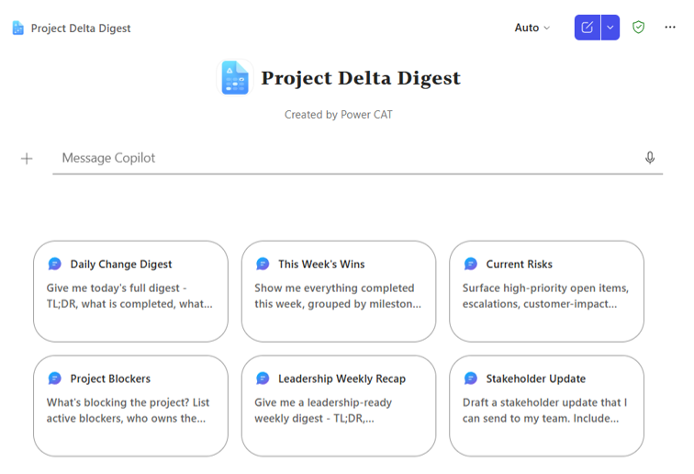
Project Delta Digest Agent Summary
Agent Overview
Key Challenges
Generate a structured, repeatable daily or weekly digest of project activity — shipped releases, current work, status changes, and risks — directly from your project management tool via a Copilot Connector.
Inefficient reporting workflows erode team productivity and delay critical business decisions
Limited visibility into project changes increases risk exposure for key stakeholders
Late identification of risks and blockers jeopardizes delivery timelines and revenue targets
Redundant backlog reviews consume high-value engineering and leadership capacity
Business Outcomes
Inefficient reporting workflows erode team productivity and delay critical business decisions
Limited visibility into project changes increases risk exposure for key stakeholders
Late identification of risks and blockers jeopardizes delivery timelines and revenue targets
Redundant backlog reviews consume high-value engineering and leadership capacity
Technical Features
💬 Conversational access via Microsoft 365 Copilot
🔗 Copilot Connector configuration available
📊 Structured digests: shipped, in-progress, status changes, risks
⚙️ Daily or weekly cadence with executive-friendly format
© 2026 Microsoft Corporation All rights reserved.

Slide 3
Table of Contents
Overview
Persona Example
User Journey Scenario Example
Solution Screenshots
Demo Prompts

Slide 4
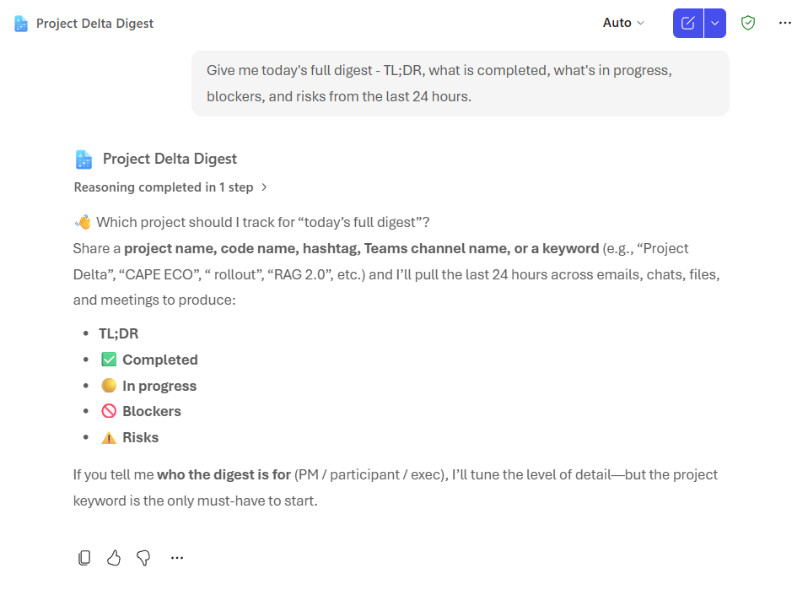
Project Delta Digest is a declarative agent that connects to your project management tool that delivers structured, scannable digests of project activity.
It automatically summarizes shipped items, work in progress, status changes, and key risks in a consistent, executive-friendly format — enabling stakeholders to understand delivery health, priorities, and impacts without manually reviewing the backend systems.
Overview
© 2026 Microsoft Corporation All rights reserved.

Slide 5


Persona Example
Two core personas: the project manager preparing updates and the engineering lead tracking delivery health.
Project Manager
Engineering Lead
Reporter
Delivery owner
Owns regular updates to leadership and stakeholders
Wants consistent, scannable summaries grounded in Jira
Tracks delivery health, scope changes, and blockers
Needs early visibility into risks to act in time
Typical Ask
Typical Ask
“What’s new in the latest release?” or “Give me a digest for the project today”
“Any risks or status changes I should know about today?”
Key Challenges Addressed
Manual status reporting is time-consuming and inconsistent; risks and changes surface late; stakeholders chase clarifications instead of acting on clear data.

Slide 6


User Journey
From a single prompt to a structured executive digest, the agent automates the daily Jira review and surfaces risks before they slip.
1
Trigger
2
Evaluation
3
Output
User asks the agent in Copilot, e.g., “What’s new in the latest release?” or “Give me today’s project digest for the project”
Agent queries the project management tool via the Copilot Connector and identifies shipped, in-progress, status changes, and risks.
Structured daily or weekly digest in executive format
Backbone
Project management tool
Microsoft 365 Graph signals
Structured digest generation

Slide 7






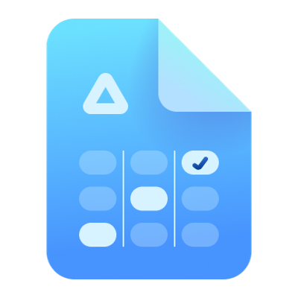



High Level Agent Architecture
Project Delta Digest Agent
How it works
User interacts with the agent via Microsoft 365 Copilot
Declarative agent queries knowledge sources (or Copilot Connectors if configured)
Agent summarizes shipped, in-progress, status changes, and risks
Returns a structured, executive-friendly digest with links
Microsoft Teams
Outlook
SharePoint
1
2
End User
Project Delta Digest Agent
Teams
Developer
Maker
Knowledge Worker
Declarative Agent
Microsoft 365 Copilot
Knowledge Sources
Copilot Connector Configurable

Slide 8
Agent Solution Screenshots
© 2026 Microsoft Corporation All rights reserved.

Slide 9
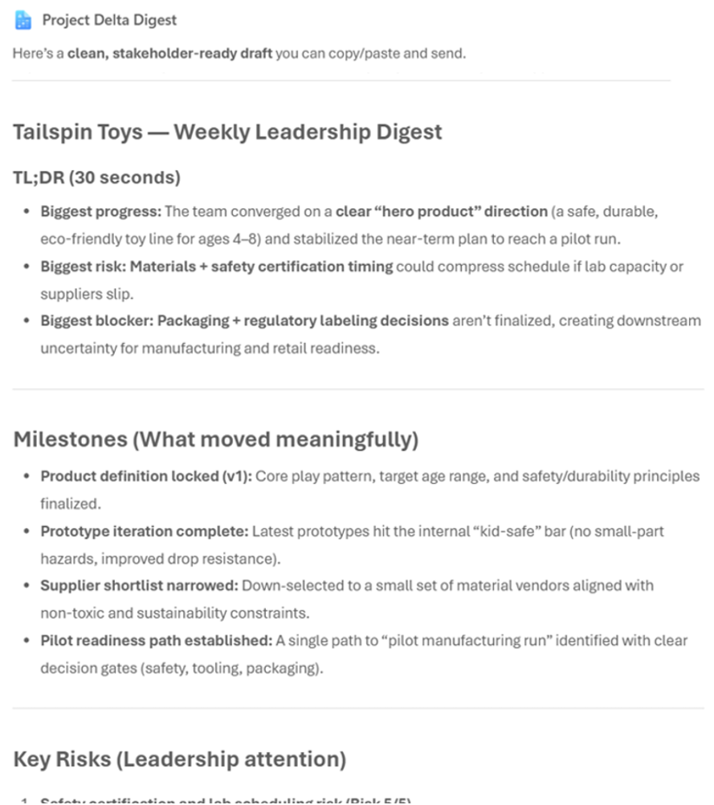
Agent Snapshot

Slide 10
Demo Prompts & Eval Set

Slide 11
Demo Prompts & Eval Set
ID | Test Scenario | Prompt | Expected Result
1 | Daily Change Digest | Give me today's full digest — TL;DR, what is completed, what's in progress, blockers, and risks from the last 24 hours. | Returns a balanced PM digest with TL;DR, Shipped, In Progress, Blockers, and Risks from the last 24 hours, with sources cited.
2 | This Week's Wins | Show me everything completed this week, grouped by milestone or deliverable, with dates and links to the source items. | Returns Done items for the week grouped by milestone, each with the completion date and a link to the source item.
3 | Current Risks | Surface high-priority open items, escalations, customer-impact issues, and compliance/budget flags, grouped by workstream. | Returns ranked risks and escalations grouped by workstream, each with a 1–5 risk score, owner, and source citation.
4 | Project Blockers | What's blocking the project? List active blockers, who owns them, and how long they've been stuck. | Returns active blockers with owner and days-stuck. Flags items idle more than 5 days.
5 | Leadership Weekly Recap | Give me a leadership-ready weekly digest — TL;DR, milestones, key risks, and momentum signals. Skip item-level detail. | Returns a one-page leadership digest — TL;DR, milestones, top risks, momentum. No detail tables.
6 | Stakeholder Update | Draft a stakeholder update that I can send to my team. Include TL;DR, milestones, top risks, and asks. | Drafts a stakeholder-ready message with TL;DR, milestones, risks, and asks — held for the user to review and send.
7 | Escalate vs Watch | What should I escalate now vs watch for another week? | Returns two grouped lists — Escalate Now vs Watch Next Week — each item with risk score, owner, rationale, and source.
8 | Proactive Questions to Ask | Tell me what I should be asking right now. | Returns 3–7 owner-targeted questions grounded in real blockers, stale items, risks, and overloaded owners.
9 | 10-Minute Leadership Brief | If I had to brief leadership unexpectedly in 10 minutes on [project name], what would matter? | Returns an ultra-concise exec brief — TL;DR, top milestones, top risks, the single ask. No item-level detail.
10 | Meeting Recap | summarize my most recent project meeting as: decision, rationale, next step. Format in a table. | Returns a 3-column table (Decision · Rationale · Next Step) sourced from the most recent project meeting, with the meeting cited.

Slide 12
Thank You

